Slide 1


Coupon Acceptance
Project Supervisor : Sagar Thapliyal
Submitted By : Yash Sharma

Slide 2
Problem Statement
The goal of this project is to leverage machine learning techniques to analyze driving scenarios and user attributes collected from an e-commerce website. By accurately predicting whether users will accept coupons during their journeys, the aim is to optimize coupon distribution strategies and enhance user engagement with the platform's offerings.
The survey describes different driving scenarios including the user’s destination, current time, weather, passenger, coupon attributes, user attributes, and contextual attributes, and then asks the user whether he/she will accept the coupon or not.

Slide 3
Problem Statement
Traditional coupon distribution methods are generic and lack personalization.
Customers often miss out on relevant discounts and offers.
Businesses struggle to target the right audience effectively.
Coupon recommendation aims to address these challenges.

Slide 4
Objective Of Project
Develop a machine learning-based system for coupon recommendation,
to provide real-time recommendations. Improve customer engagement and increase sales for participating businesses. The aim of the project is to create an "Coupon Recommendation System”
This is a machine learning Classification case study"

Slide 5
About Data
The dataset contains 25 features, 12684 Row
Categorical variables: 17
Integer variables: 8
Float variables: 0

Slide 6
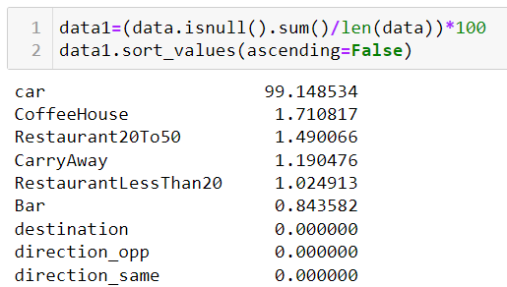
Missing Values

Slide 7
Drop Missing Values
data=data.drop('car', axis=1)
Car column contain more then 99% missing values so that we drop car column

Slide 8
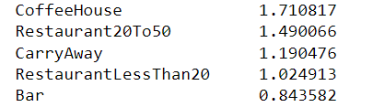
“na” Values

Slide 9
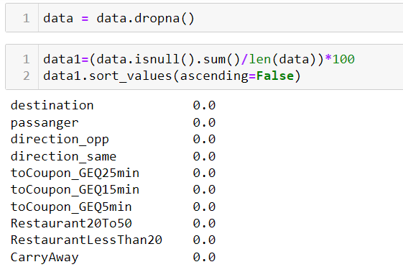
Drop “na” Values

Slide 10
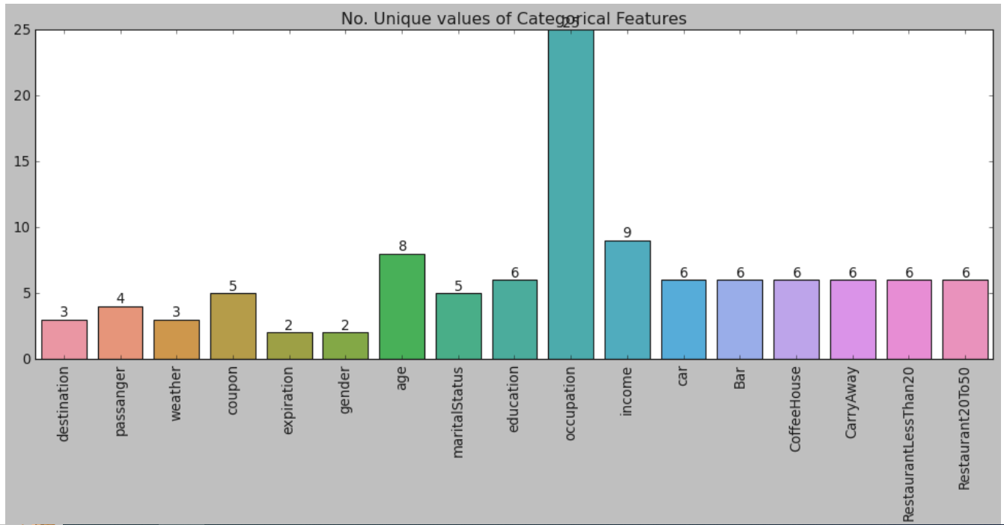
Number Of Unique Value In Categorical Column

Slide 11
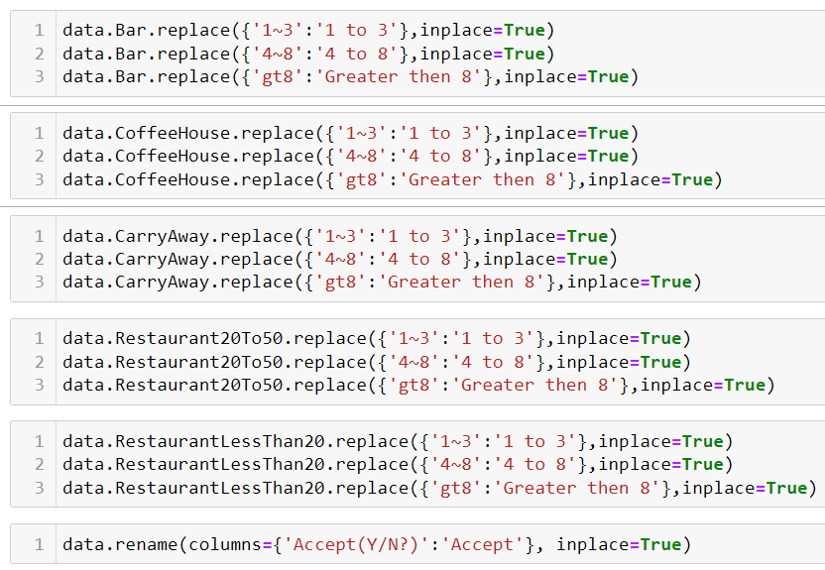
Cleaning Dataset

Slide 12
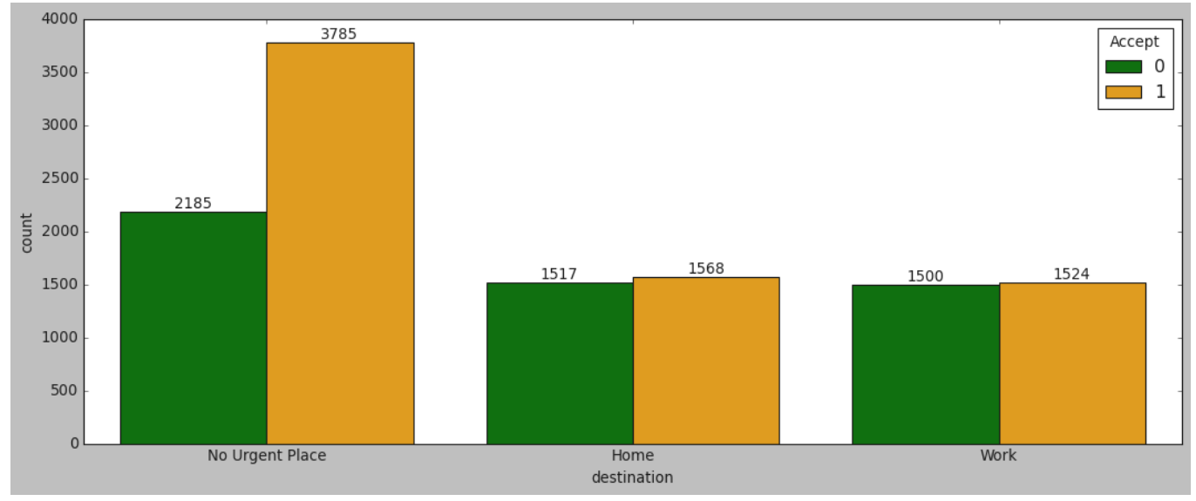
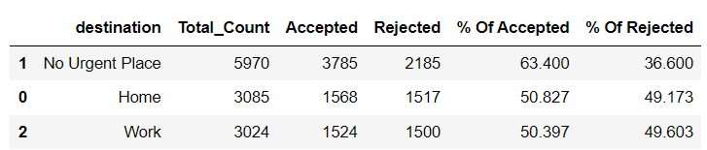
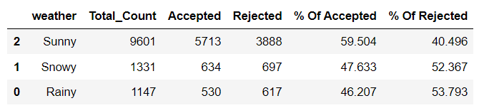
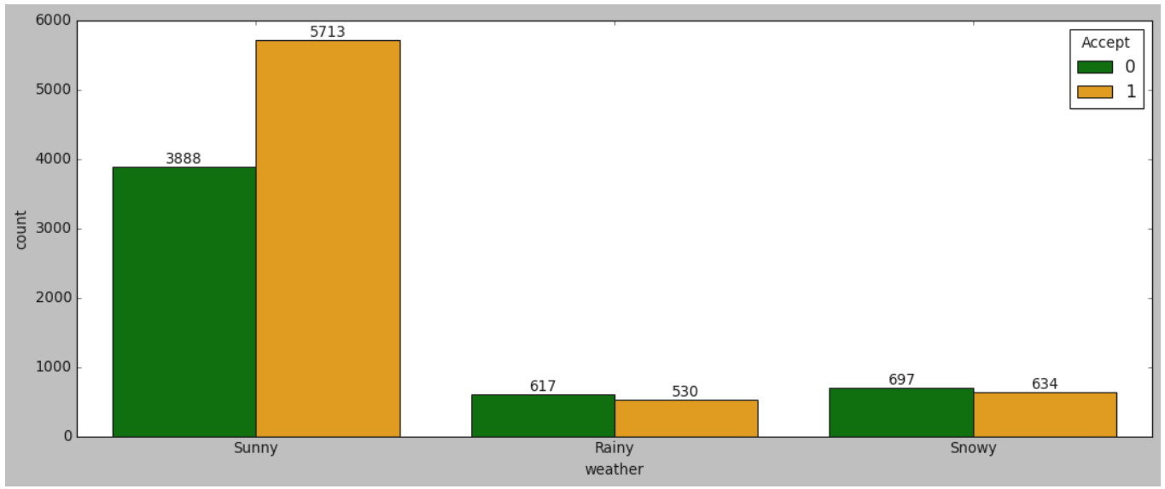
Univariate Analysis
There are 63.4% chance when destination is “no urgent place”
When weather is sunny there are more chance to accept coupon.

Slide 13
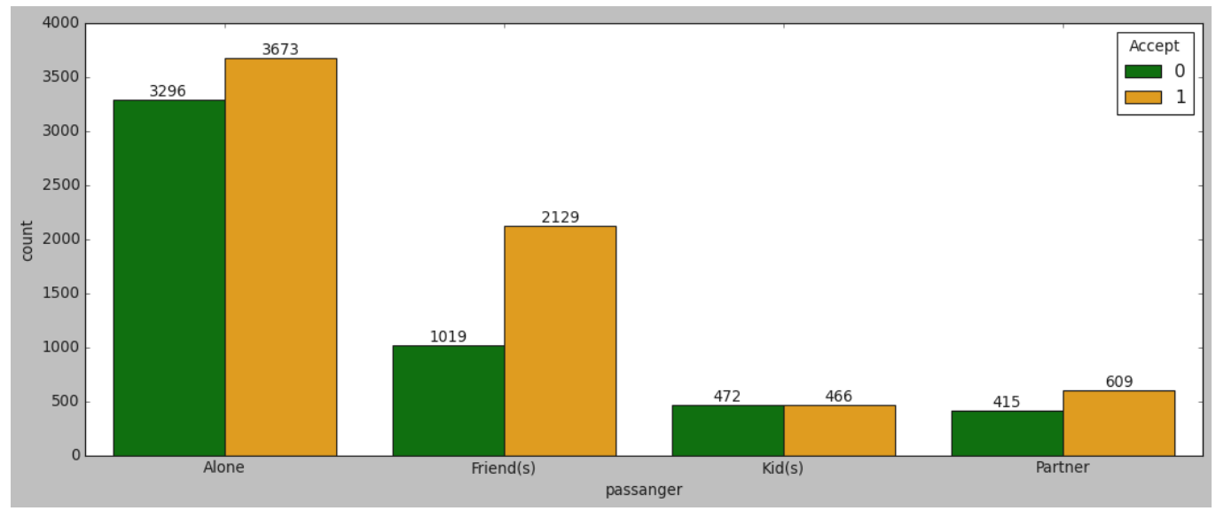
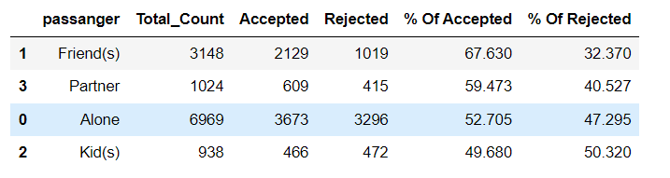
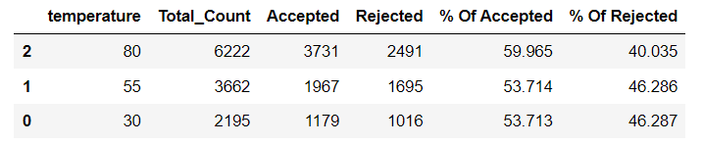
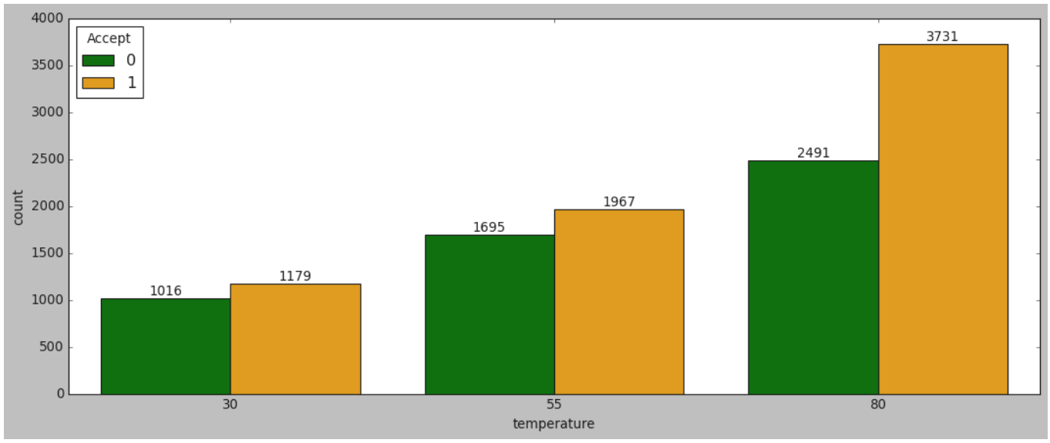
Univariate Analysis
There are 67.6% chance when passenger with friends
Only 53-59% user accept coupon temperature does not matter

Slide 14
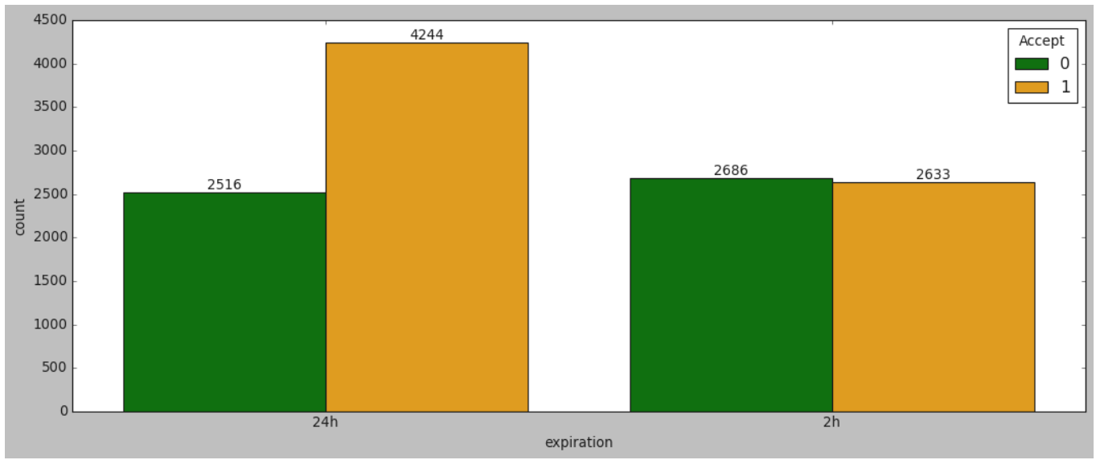
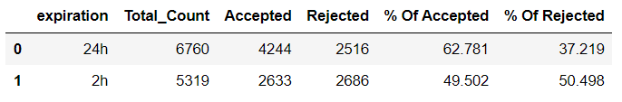
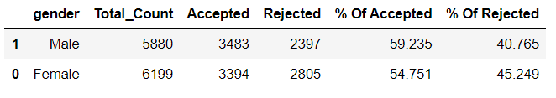
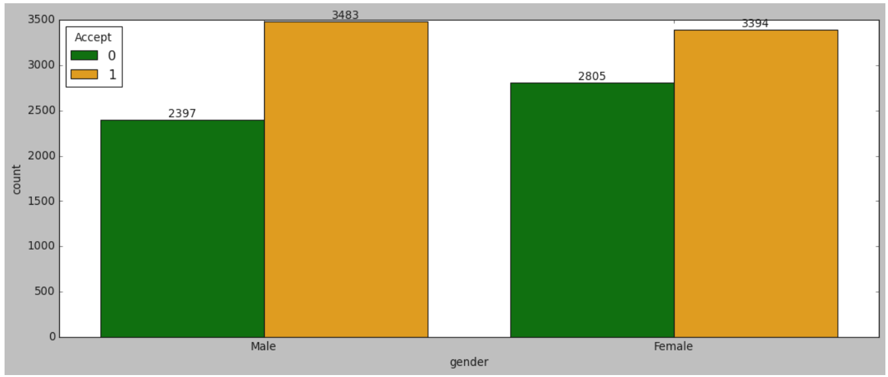
Univariate Analysis
There are 62.7% probability of acceptance of coupon, if expiration is 24 hour
Gender column impact almost same for both male and female

Slide 15
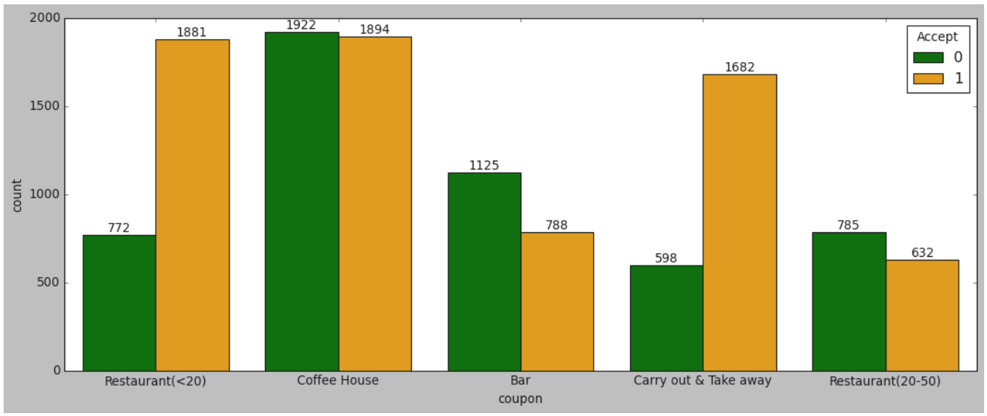
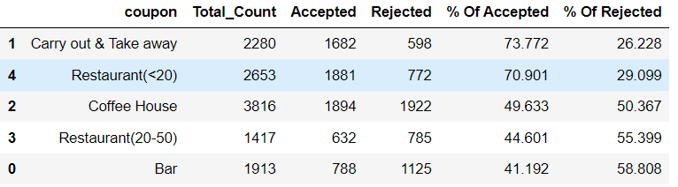
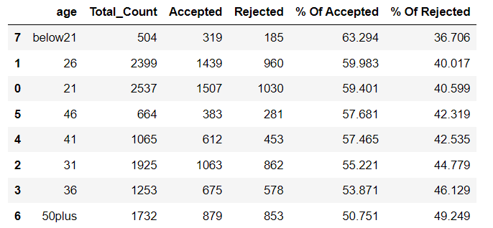
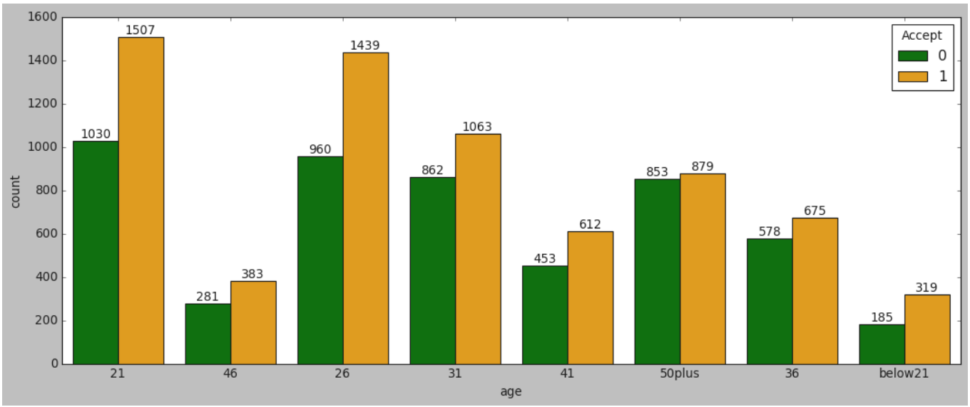
Univariate Analysis
“Carry out & take away” and Restaurant <20 has greater chance to accept coupon other then

Slide 16
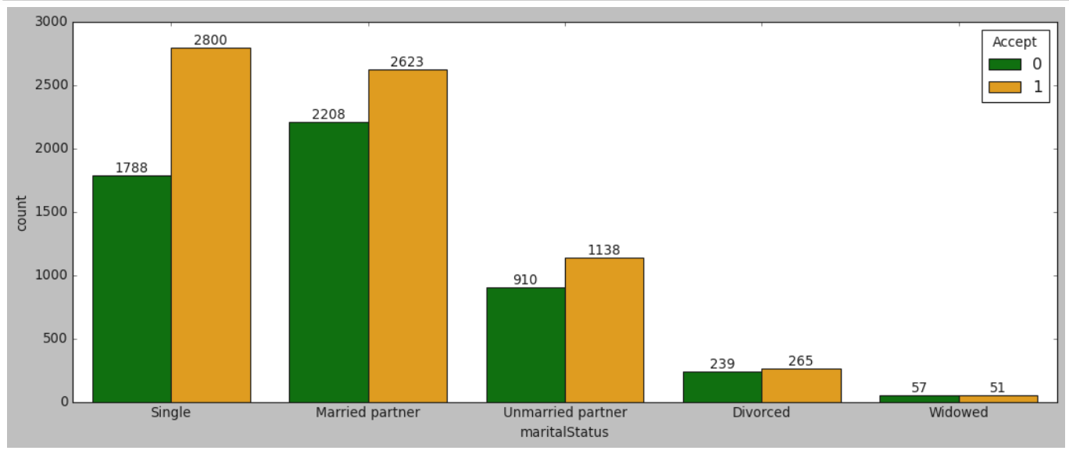
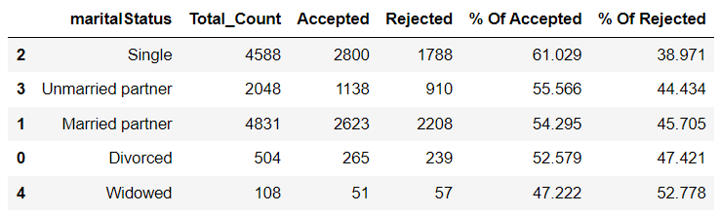
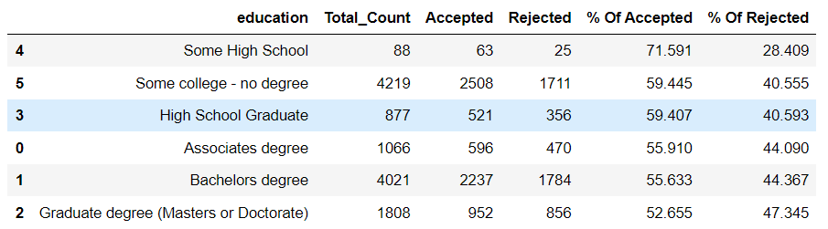
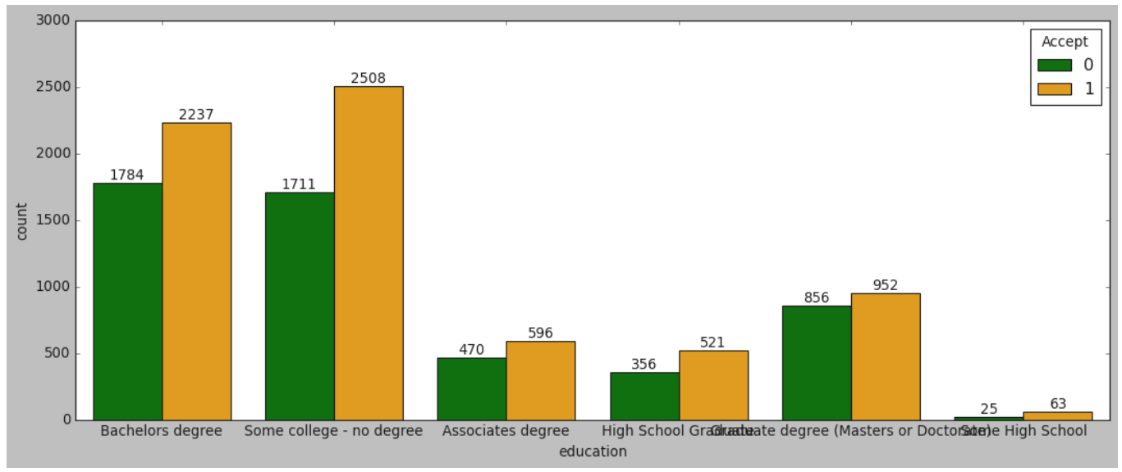
Univariate Analysis
If education is “Some high school” greater chance to accept coupon.

Slide 17
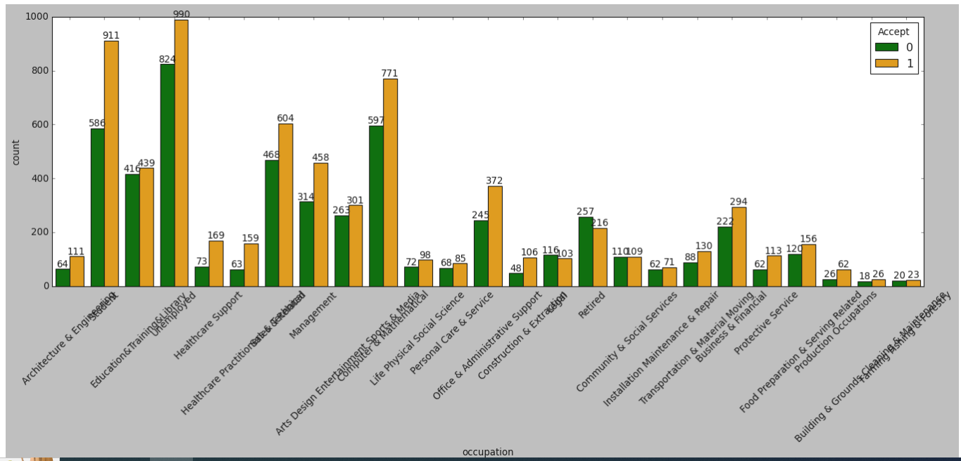
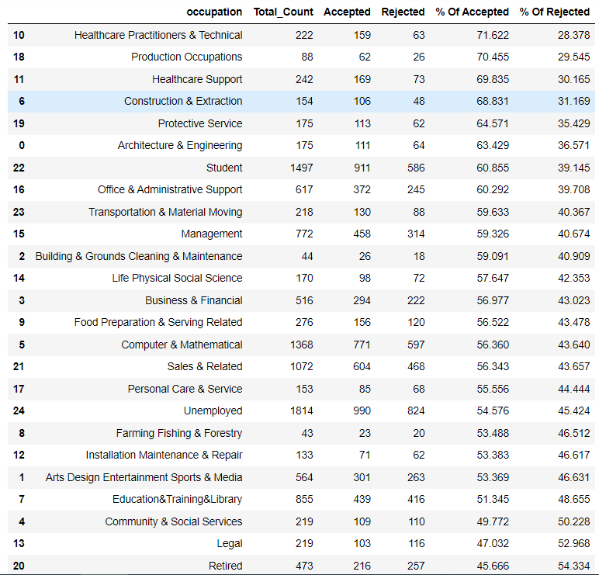
Univariate Analysis
If user occupation retired only 45.6% chance of accepting coupon but more chance when he or she is from health care

Slide 18
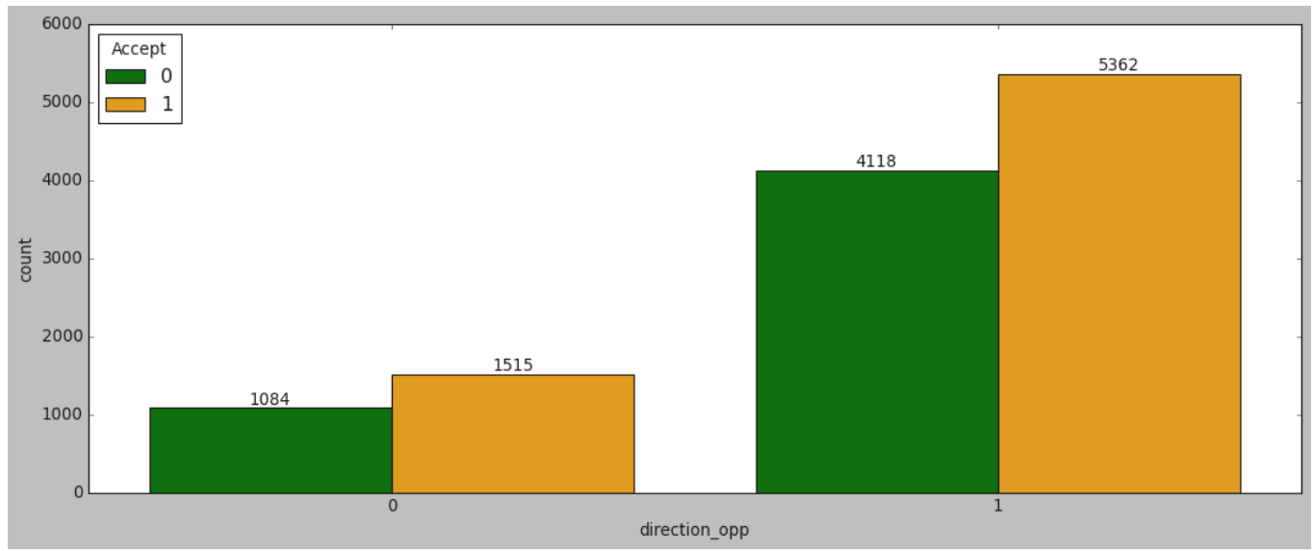


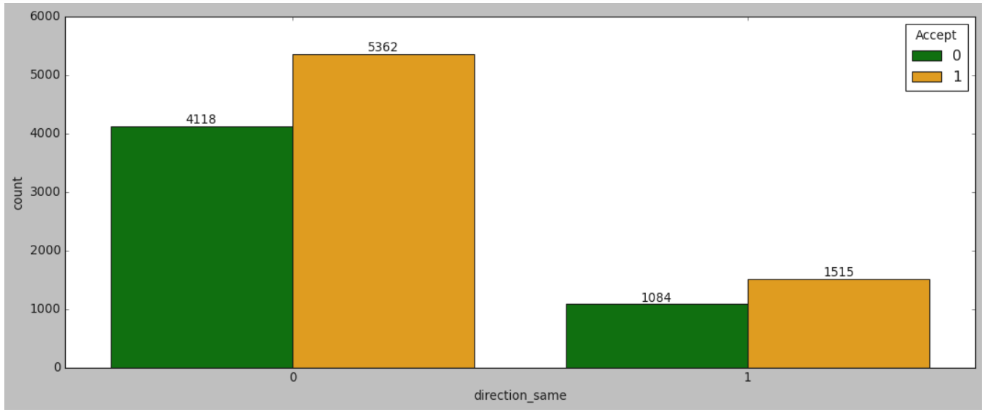
Univariate Analysis
Direction Same Or Opposite has same impact

Slide 19
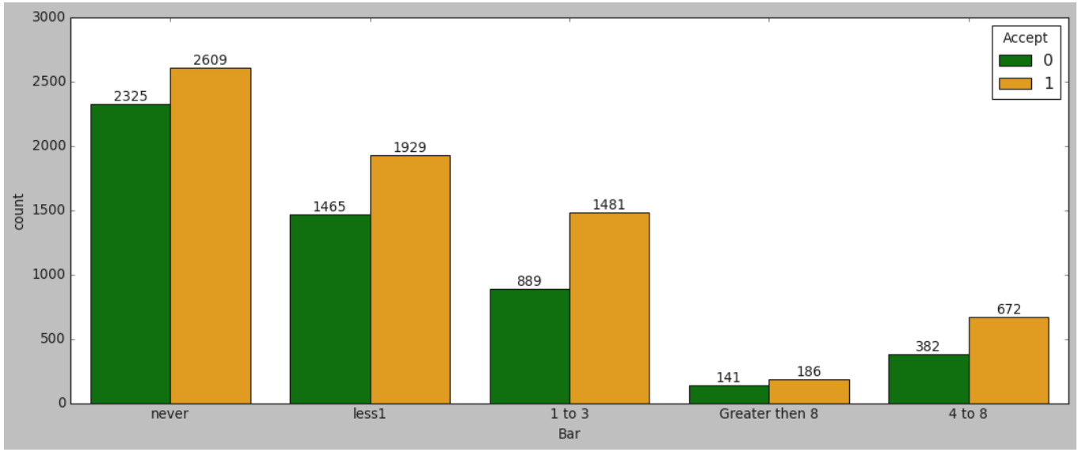
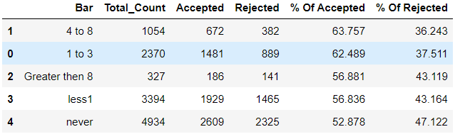
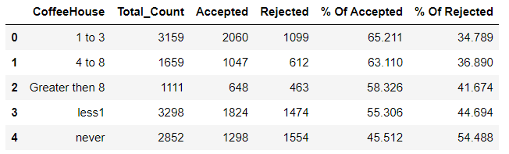
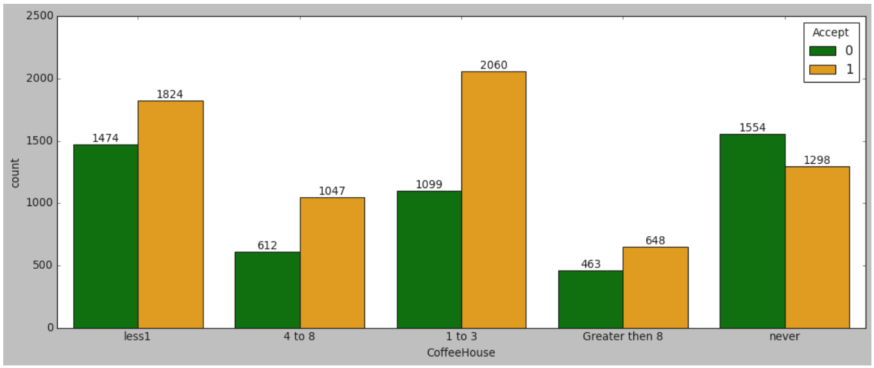
Univariate Analysis
There are more chance to accept coupon when user in coffee house between 1-3
User in coffee house or user in Bar there are same chance to accept coupon

Slide 20
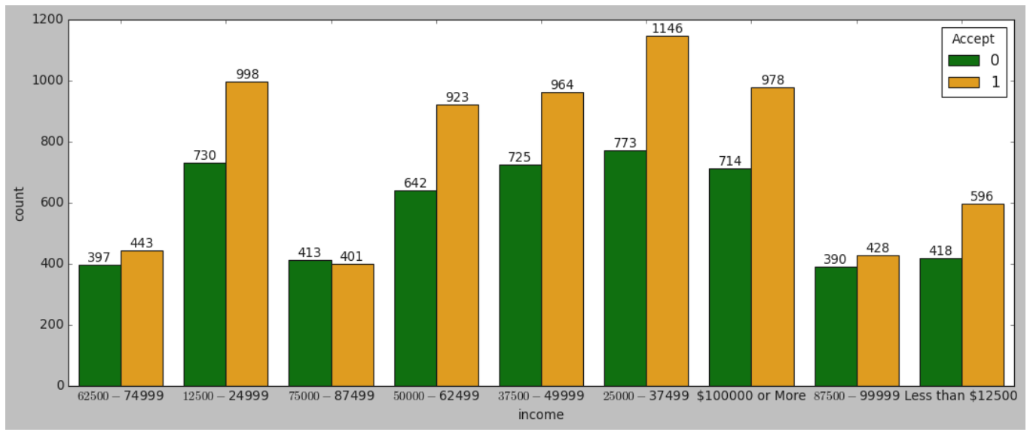
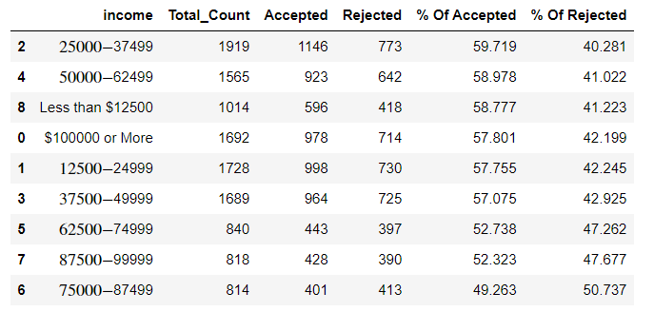
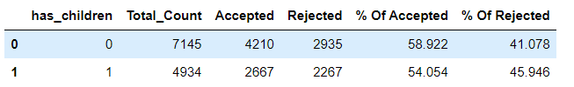
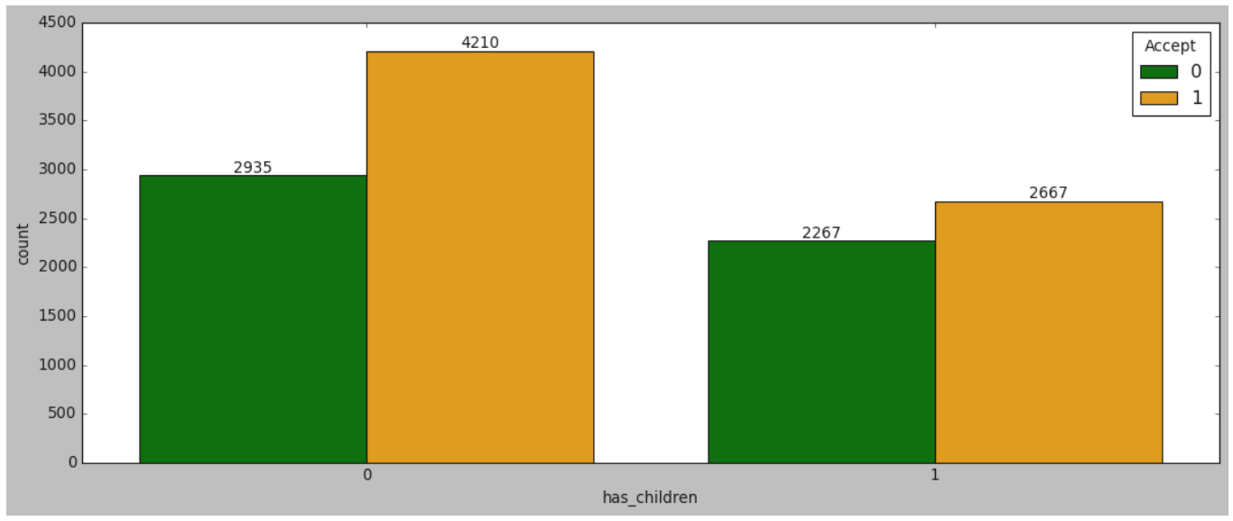
Univariate Analysis

Slide 21
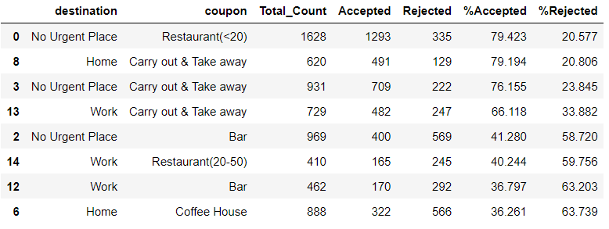
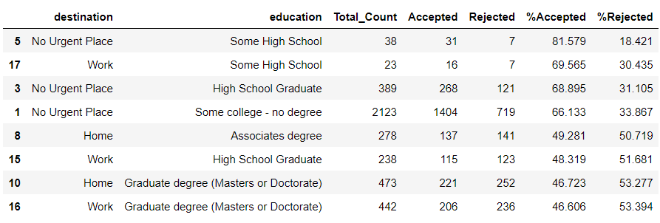
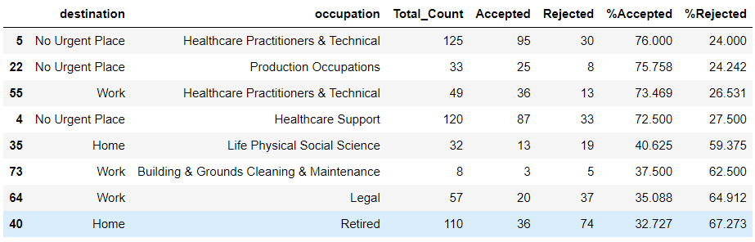
Bivariate Analysis
When destination is no urgent place and education is some high school more chance to accept the coupon
Same as destination is no urgent place and coupon is restaurant<20 79.23% chance to accept the coupon
Same as destination is no urgent place and occupation is health care 76% chance to accept the coupon
As per result table destination is Home and occupation is retired only 33% chance to accept the coupon

Slide 22
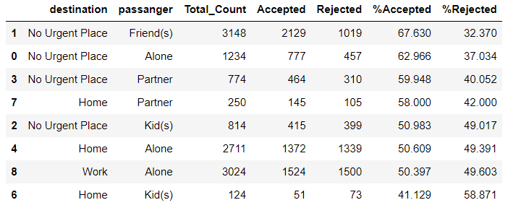
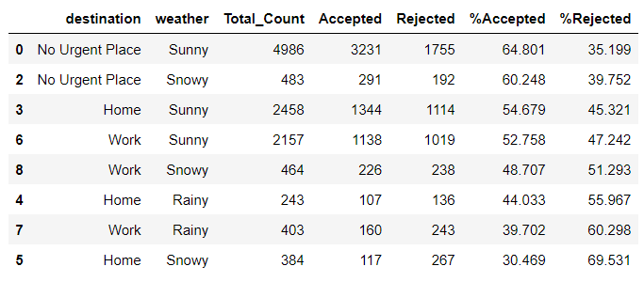
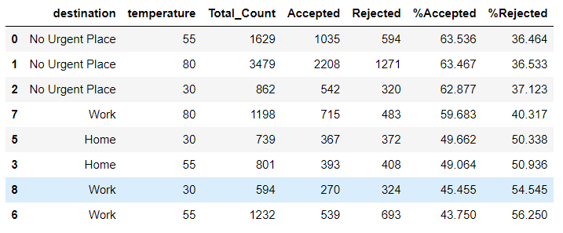
Bivariate Analysis
When destination is no urgent place and passenger with friend more chance to accept the coupon
Same as destination is no urgent place and weather is sunny 64.8% chance to accept the coupon
As per result table no urgent place with any temperature more chance to accept the coupon

Slide 23
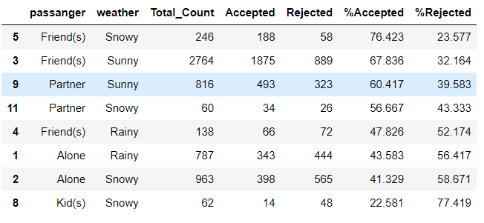
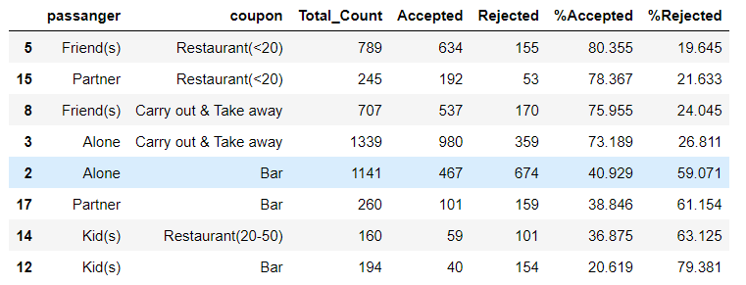
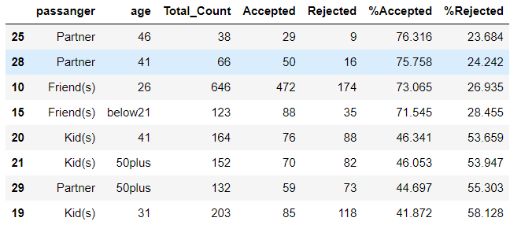
Bivariate Analysis
When Passenger with Friends and Weather is Snowy more chance to accept the coupon
When Passenger with Partner and Age is 46 more chance to accept the coupon
When Passenger with Friends and Coupon from (restaurant<20) 80% chance to accept the coupon
As per result table Passenger with kids and Whether is Snowy only 22% chance to accept the coupon

Slide 24
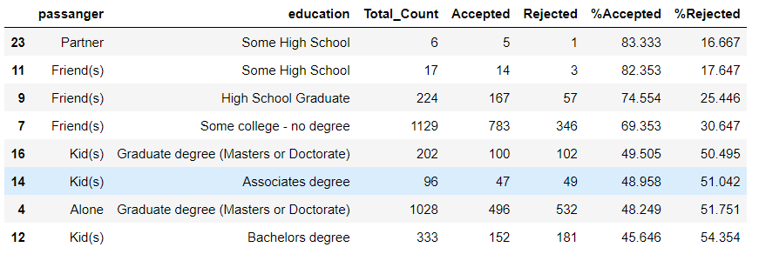
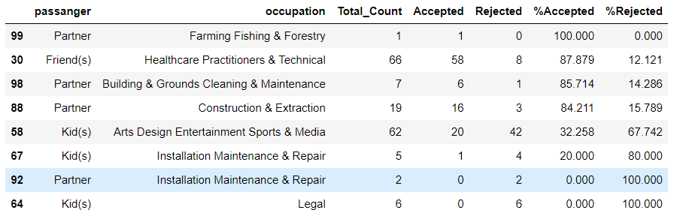
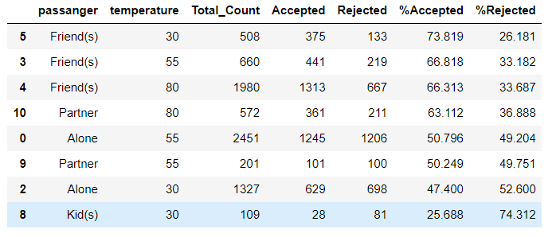
Bivariate Analysis
When Passenger with Partner and Occupation is Maintenance or legal 100% chance to accept the coupon
When Passenger with Partner and Education is Some high School 83% chance to accept the coupon
When Passenger with Friends and Temperature is 30 73% chance to accept the coupon
As per result table Passenger with Friends and Occupation is health care 87% chance to accept the coupon

Slide 25
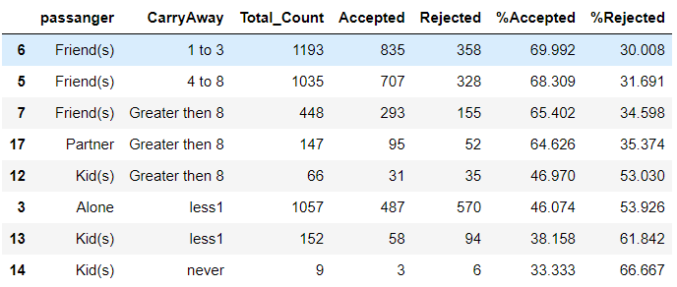


Bivariate Analysis
When Passenger with Partner or kids and Bar time is Greater then 8 more then 75% chance to accept the coupon
When Passenger with Friends and Coffee house time between 1-3 78% chance to accept the coupon
When Passenger with Friends and Carry Away Time Between 1-8 there are more then 68% chance to accept the coupon

Slide 26



Bivariate Analysis
when weather is sunny & coupon feature show restaurant<20 or carry our & take away more then 76% chance of accept the coupon
But vey less chance when weather is snowy and coupon feature show restaurant(20-50) or Bar only 30% chance of acceptance
When weather is sunny and user is male 61% chance to accept the coupon then female

Slide 27



Bivariate Analysis
When Temperature 80 and Coffee house timing greater then 1, more then 62% chance to accept the coupon.
When Temperature 80 and Bar timing between 1-8, more then 64% chance to accept the coupon

Slide 28



Bivariate Analysis
When coupon {carry out or restaurant<20} and carry away feature show never there are 78% chance to accept the coupon.
But coupon feature show “Bar” And Carry Away feature show never result totally opposite only more then 82% chance user reject the coupon.
As per the result table temperature 30 and occupation is production 82% chance user accept coupon

Slide 29
Feature Engineering
Create new variable to_Coupon which is combination of two feature, toCoupon_GEQ15min and toCoupon_GEQ25min

Slide 30

Correlation Between Feature

Slide 31
Conclusion
Algorithm | Accuracy Score
1. Decision tree | 69%
2. Random Forest | 75.08%
3. XG Boost | 75.91%
4. Logistic Regression | 68.05%
5. Gradient Boost | 72.43%
6. Ada Boost | 68.54%
7. Bagging Classifier | 73.63%

Slide 32
Thank You

Slide 33
Yash Sharma
Assistant Professor
Exp: 8+Year
Mob:9691173377
yash.versatile@gmail.com

